Slide 1
Timing

Slide 2
Index
Propagation and Contamination Delay
Critical paths
Glitches
Wire delay
Timing of sequential logic
Dynamic Discipline
Timing Specification
System Timing
Setup Time and Hold Time Constraints
Timing Analysis
Fixing Hold Time Violations
Clock Skew
Metastability
Resolution Time
Synchronizers
System reliability

Slide 3
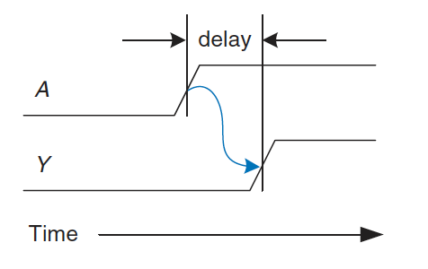
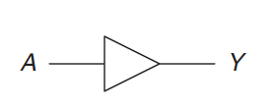
Delay
One of the most challenging issues in circuit design is timing
making a circuit run fast
An output takes time to change in response to an input change
circuit delays are on the order of picoseconds (10⁻¹²) to nanoseconds (10⁻⁹)
Timing diagram
the transient response of the buffer circuit when an input changes
transition from LOW to HIGH is called the rising edge
transition from HIGH to LOW is called the falling edge
The blue arrow indicates that the rising edge of Y depends on the rising edge of A
Delay is measured from 50% point of the input to 50% point of the output

Slide 4
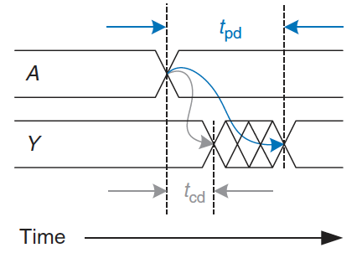
Propagation and Contamination Delay
propagation delay t_{pd}
maximum time from when the input changes until the output reaches its final value
contamination delay t_{cd}
minimum time from when the input changes until the output starts to change its value
The figure shows that A is initially either HIGH or LOW and changes to the other state at a particular time
we are interested only in the fact that it changes, not what value it has
In response, Y changes some time later
Y starts to change t_{cd} after A transitions
Y definitely settles to its new value within t_{pd}.
The causes of delay include the time required to charge the capacitance in a circuit and the speed of light
calculating t_{pd} and t_{cd} requires delving into the lower levels of abstraction
manufacturers supply data sheets specifying these delays for each gate

Slide 5
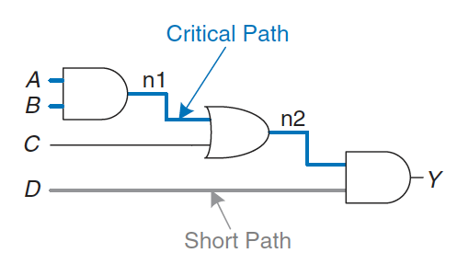
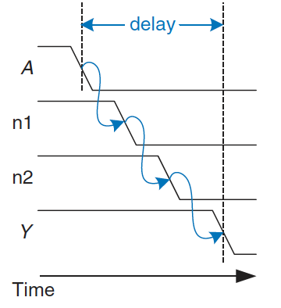
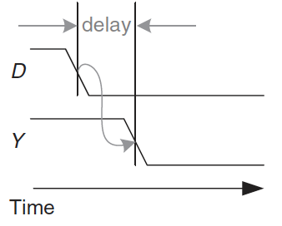
Critical path
Delays are also determined by the path a signal takes from input to output
The critical path is the longest (slowest) path
the input travels through more gates to the output
it is “critical” because it limits the speed at which the circuit operates
the propagation delay of a circuit is the sum of the propagation delay of all element on the critical path
t_{pd} = 2 t_{pd_AND} + t_{pd_OR}
The short path is the shortest (fastest) path
the input travels through the minimum number of gates to the output
the contamination delay is the sum of the contamination delays through each element on the short path
t_{cd} = t_{cd_AND}

Slide 6
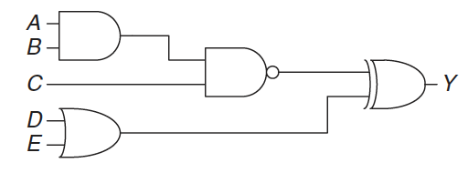
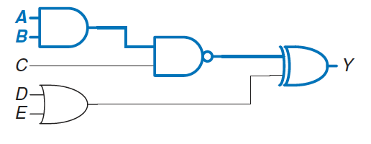
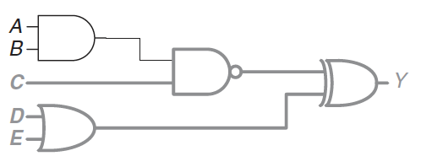
Finding delays
Find the propagation delay and contamination delay of the following circuit
According to the datasheets, each gate has a propagation delay of 100ps and a contamination delay of 60ps
The critical path is from input A or B through three gates to the output Y
hence, t_{pd} is three times the propagation delay of a single gate, 300ps
The shortest path is from input C, D, or E through two gates to the output Y
so t_{cd} is 120ps

Slide 7
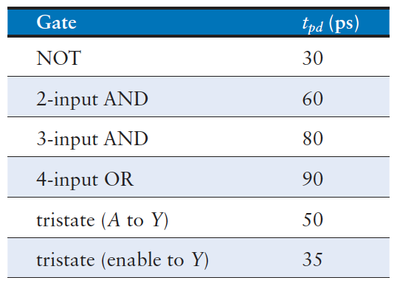
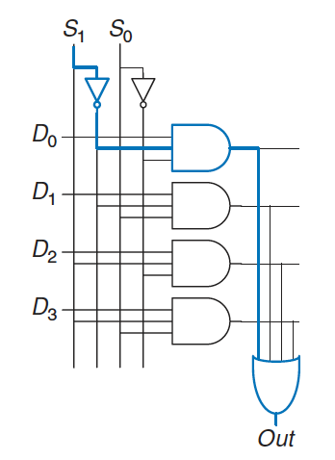
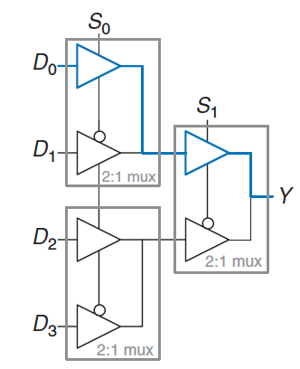
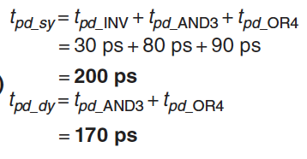

Control-critical vs data-critical
Compare the worst-case timing of the two four-input multiplexer designs (two-level logic vs multiplexer logic)
Critical paths:
two-level logic is control critical: the critical path is from the control to the output
multiplexer logic is data critical: the critical path is from the inputs to the output
if data arrive before the control, we prefer the design with the shortest control delay
if the control arrive before the data, we prefer the design with the shortest data delay
The best choice depends on the power, cost, and availability of parts

Slide 8
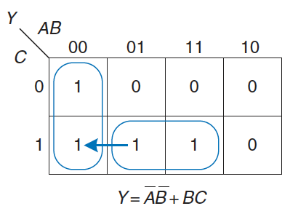
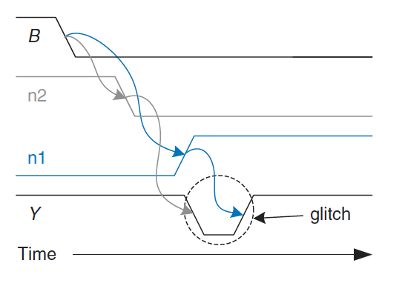
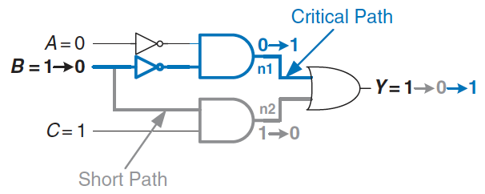
Glitches (1)
It is possible that a single input transition can cause multiple output transitions: glitches or hazards
Transition across the boundary of two prime implicants in the K-map indicates a possible glitch
As long as we wait for the propagation delay to elapse before we depend on the output, glitches are not a problem

Slide 9
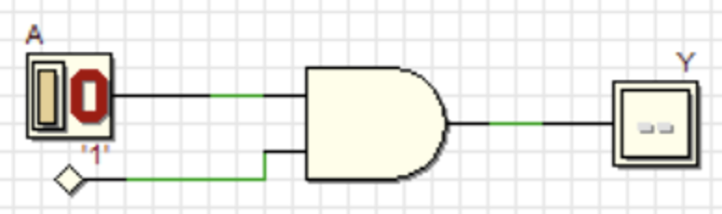
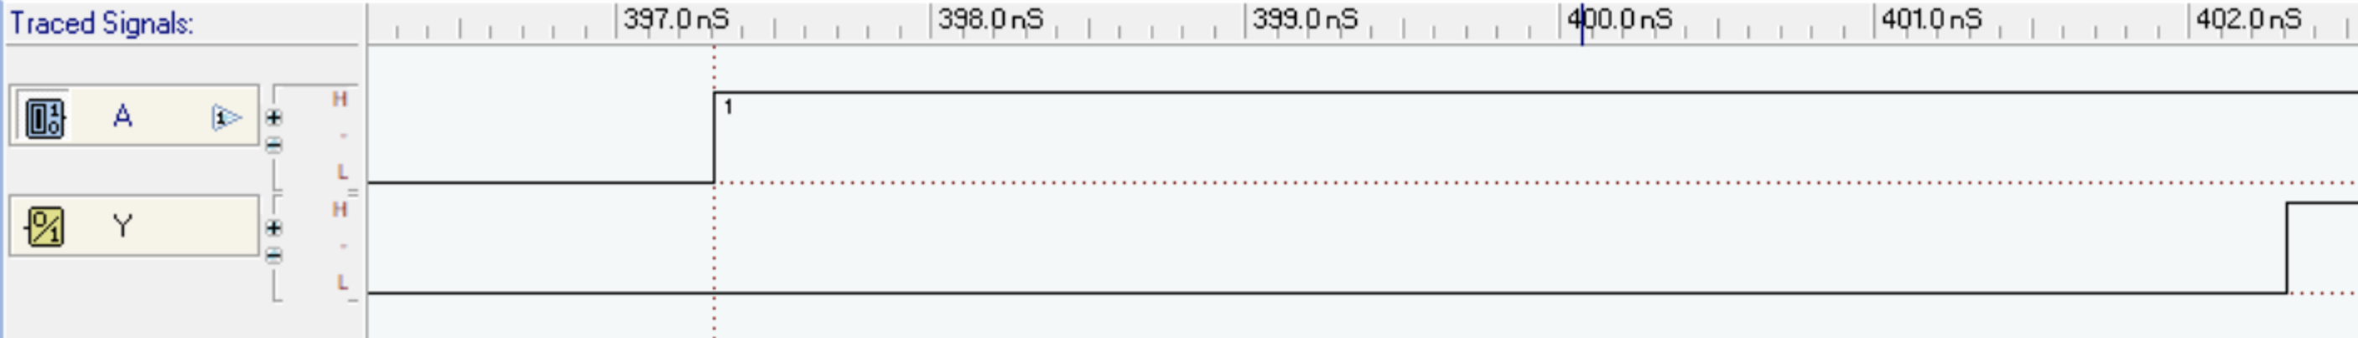
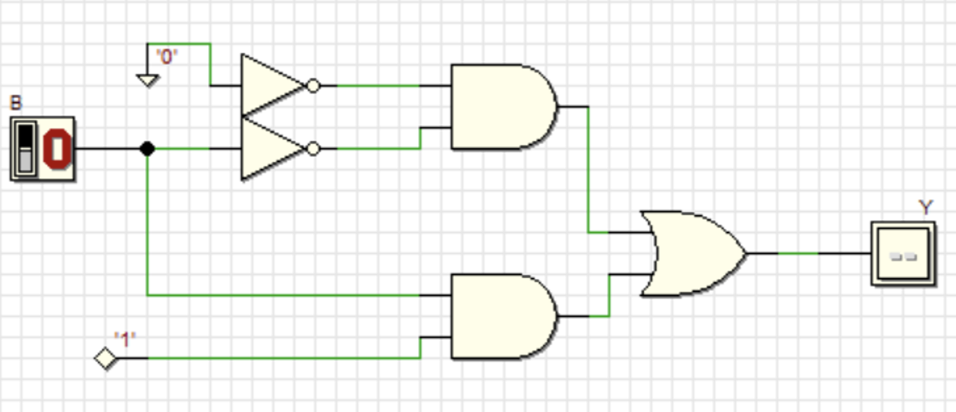
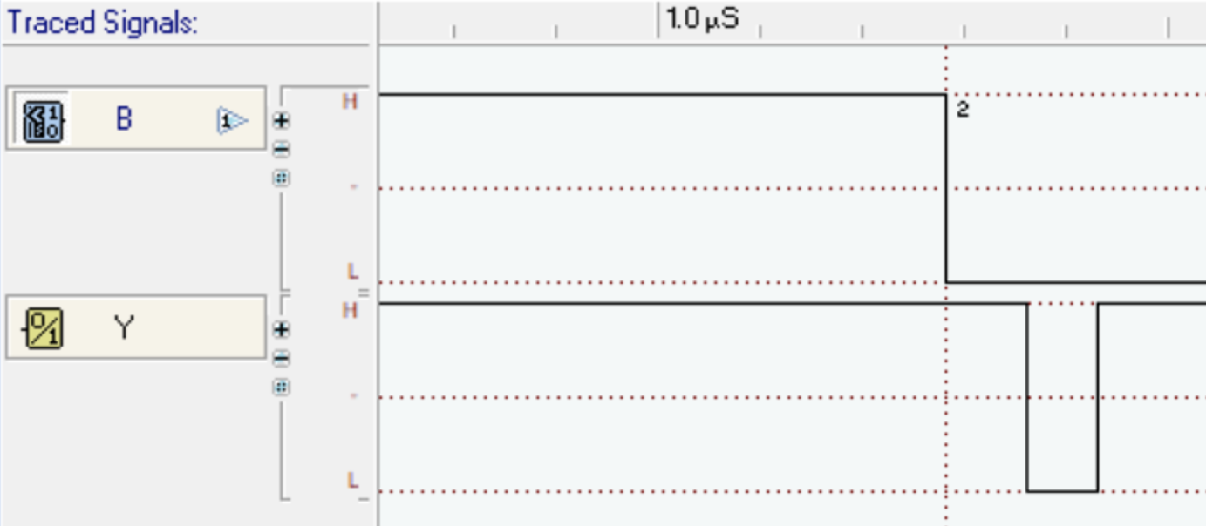
Glitches (2)
The DEEDS simulator take into account the propagation delay (5ns):
and this glitch effect can be seen in the simulation (zooming enough):

Slide 10
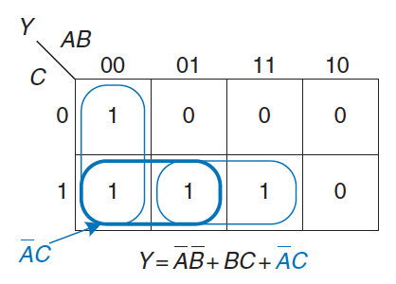
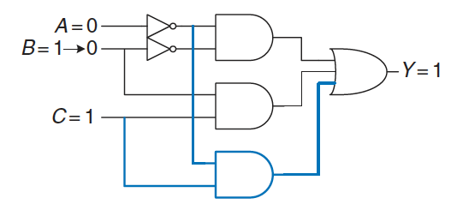
Glitches (3)
We can eliminate glitches by adding redundant implicants to the K-map to cover these boundaries
at the cost of extra hardware
However, simultaneous transitions on multiple inputs can also cause glitches that cannot be fixed by adding hardware
The vast majority of interesting systems have these simultaneous transitions, then glitches are a fact of life in most circuits
The point is not to eliminate them but to be aware that they exist
this is especially important when looking at timing diagrams on a simulator or oscilloscope

Slide 11
Wire delay
We have assumed that wires are equipotential connections that have a single voltage along their entire length
However, signals propagate along wires at the speed of light in the form of electromagnetic waves
if wires are short enough or signals change slowly, the assumption is good enough
when wires are long or signals are very fast, the transmission time along the wire becomes important to accurately determine the circuit delay
We model such wires as transmission lines
in which a wave of voltage and current propagates at the speed of light
when the wave reaches the end of the line, it may reflect back along the line, causing noise and odd behaviours
Whenever the wire delay is shorter than a fraction (typically 20%) of the edge rates (rise or fall times) of a signal it has an insignificant effect

Slide 12
Timing of sequential logic
A flip-flop copies input D to output Q on the rising edge of the clock (sampling)
if D is stable (0 or 1) when the clock rises, the behaviour is clearly defined
what happens if D is changing at the same time the clock rises?
The problem is similar to that faced by a camera when snapping a picture
it is characterized by its aperture time, during which the object must remain still for a sharp image to be captured
A sequential element has an aperture time around the clock edge, during which the input must be stable for the flip-flop to produce a well-defined output
setup time before the clock edge
hold time after the clock edge
As the static discipline (limits us to using logic levels outside the forbidden zone), the dynamic discipline limits us to signals that change outside the aperture time
we can think of time in discrete units called clock cycles, just as we think of signal levels as discrete 1’s and 0’s
a signal may glitch and oscillate for some bounded amount of time, we are concerned only about its final value at the end of the clock cycle

Slide 13
Dynamic Discipline
We can write A[n] (the value of signal A at the end of the n-th clock cycle, rather than A(t), where t is any real number
the clock period has to be long enough for all signals to settle
a limit on the speed of the system
In real systems, the clock does not reach all flip-flops at precisely the same time
clock skew
further increases the necessary clock period
Sometimes it is impossible to satisfy the dynamic discipline, especially when interfacing with the real world
consider a circuit with an input coming from a button, we might press the button just as the clock rises
this result in a phenomenon called metastability
flip-flop captures a value between 0 and 1
that can take an unlimited amount of time to resolve into a good logic value

Slide 14
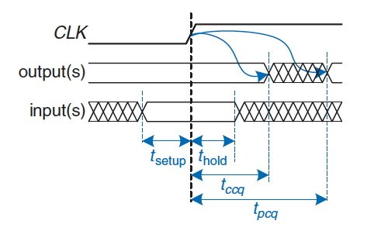
Timing Specification
When the clock rises, the output…
…may start to change after the clock-to-Q contamination delay (t_{ccq})
the fastest delays through the circuit
…will definitely settle to the final value within the clock-to-Q propagation delay (t_{pcq})
the slowest delays through the circuit
The input…
….must have stabilized at least setup time (t_{setup}) before the rising edge of the clock
…must remain stable for at some hold time (t_{hold}) after the rising edge of the clock
The sum of setup and hold times is called the aperture time of the circuit, because it is the total time for which the input must remain stable

Slide 15
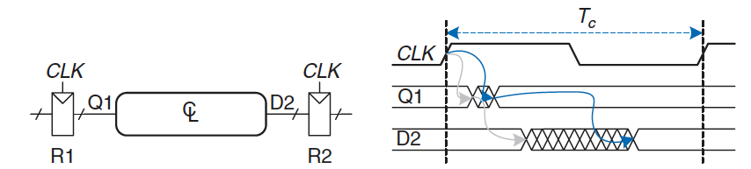
System Timing
The clock period or cycle time (Tc) is the time between rising edges of a repetitive clock signal
Its reciprocal fc = 1/Tc is the clock frequency
measured in units of Hertz (Hz) or cycles per second
increasing frequency increases the work a digital system can accomplish per unit time
Consider a generic path in a synchronous sequential circuit
output signals may start to change a contamination delay after input changes
grey arrows
output signals settles to the final value within a propagation delay after its input settles
blue arrows
We can analyse the timing constraints with respect to the setup and hold time of the second register

Slide 16

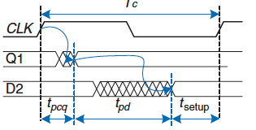
Setup Time Constraint
To satisfy the setup time of R2, D2 must settle no later than the setup time before the next clock edge
minimum clock period
Tc > t_{pcq} + t_{pd} + t_{setup}
In commercial designs, usually the only variable under the control of the designer is the maximum propagation delay through the combinational logic
clock period is dictated by the marketing department (to ensure a competitive product)
the flip-flop delay and setup time are specified by the manufacturer
t_{pd} > Tc - (t_{pcq} + t_{setup})
if the propagation delay through the combinational logic is too long, its output may not have settled to final value by the time next input needs it to be stable
Ideally, the entire cycle time Tc would be available for useful computation in the combinational logic. The sequencing overhead (t_{pcq} + t_{setup}) cuts this time

Slide 17
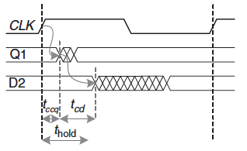

Hold Time Constraint
To satisfy the hold time of R2, D2 must not change until the hold time after the rising edge of the clock
t_{ccq} + t_{cd} > t_{hold}
Again, t_{ccq} and t_{hold} are characteristics of the flip-flop that are usually outside the designer’s control
Minimum contamination delay through the combinational logic
t_{cd} > t_{hold} – t_{ccq}
We expect that two flip-flops may be directly cascaded
in such a case, t_{cd}=0 (no combinational logic) in between and t_{hold} < t_{ccq}
a reliable flip-flop must have a hold time shorter than contamination delay
often, flip-flops are designed with t_{hold}=0
We usually ignore the hold time constraint
nevertheless, it is critically important
if violated, the only solution is to increase the contamination delay through the logic
which requires redesigning the circuit
unlike setup time constraint, it cannot be fixed by adjusting the clock period

Slide 18
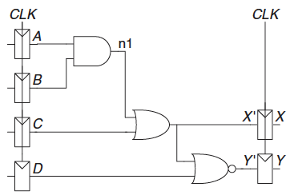
Timing Analysis (1)
Sequential circuits have setup and hold time constraints that dictate the maximum and minimum delays of the combinational logic between flipflops
modern flip-flops are usually designed so that the minimum delay through the combinational logic can be 0
the maximum delay constraint limits the number of consecutive gates on the critical path of a circuit
Consider the circuit in figure and determine the maximum clock frequency and whether any time violations could occur
Flip-flops: t_{ccq}=30ps; t_{pcq}=80ps; t_{setup}=50ps; t_{hold}=60ps
Logic gates: t_{cd}=25ps; t_{pd}=40ps

Slide 19
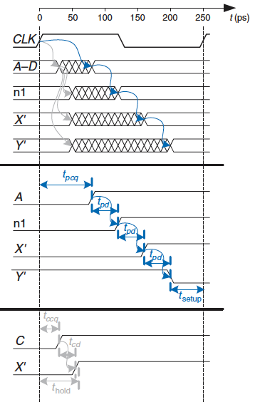
Timing Analysis (2)
Critical path:
B=1, C=0, D=0, A rises from 0 to 1, triggering n1 to rise, X′ to rise, and Y′ to fall
assume gates require full propagation delay
three gate delays
Y′ must set up before the next rising edge of the CLK
Maximum clock frequency:
Tc>t_{pcq}+t_{pd}+t_{setup}= 80ps+3*40ps+50ps= 250ps
fc = 1/Tc = 4 GHz
t_{ccq}=30ps; t_{pcq}=80 ps; t_{setup}=50 ps; t_{hold}=60 ps
t_{pd}=40 ps; t_{cd}=25 ps

Slide 20
Timing Analysis (3)
Shortest path:
A=0; C rises, causing X′ to rise
assume gates switch after only contamination delay
only one gate delay
Hold Time Constraint
t_{hold} < t_{ccq} + t_{cd} = 30ps + 25ps = 55ps
t_{hold} = 60ps
the circuit has a hold time violation and may behave erratically at any clock frequency
t_{ccq}=30ps; t_{pcq}=80 ps; t_{setup}=50 ps; t_{hold}=60 ps
t_{pd}=40 ps; t_{cd}=25 ps

Slide 21
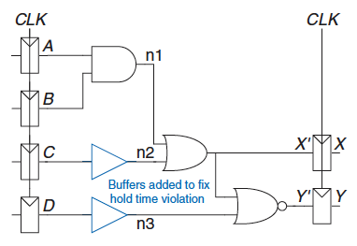
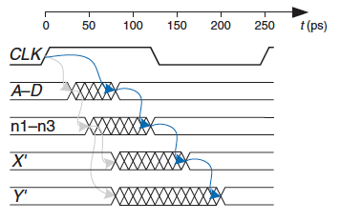
Fixing Hold Time Violations
A possible solution is to add buffers to slow down the short paths
Short paths are slowed by the contamination delay of the buffer
X′ will not change until t_{ccq} + 2*t_{cd} = 30ps+2*25ps = 80ps > t_{hold}
Critical path is unaffected because it does not pass through any buffers
the maximum clock frequency is still 4 GHz
In general, adding buffers can usually (not always) solve hold time problems without slowing the critical path
the example had an unusually long hold time to illustrate the problems
most flip-flops are designed with t_{hold} < t_{ccq} to avoid such problems

Slide 22
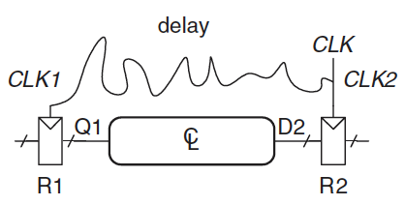
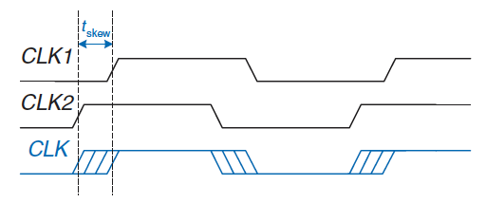
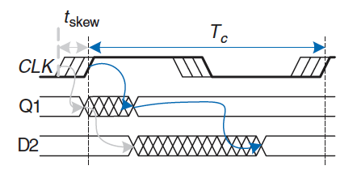
Clock Skew (1)
We assumed that the clock reaches all registers at exactly the same time
In reality, there is some variation in this time
the wires from the clock source to different registers may be of different lengths, resulting in slightly different delays
noise also results in different delays
When doing timing analysis, we have to consider the worst-case scenario so that we can guarantee that the circuit will work under all circumstances
We can adds skew to the timing diagram
heavy clock line indicates the latest time at which the clock signal might reach any register
hashed lines show that the clock might arrive up to t_{skew} earlier

Slide 23
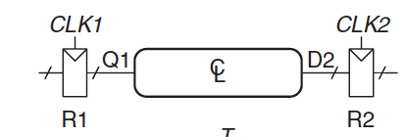
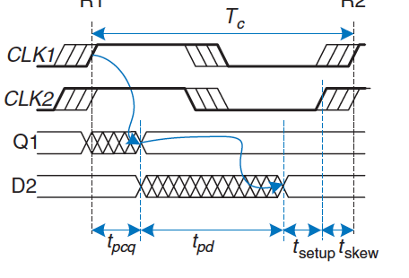
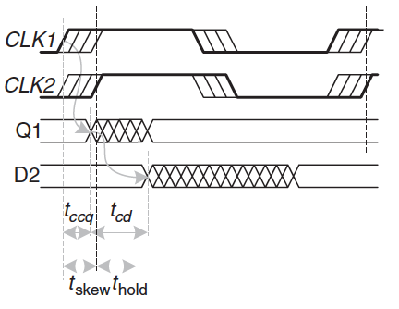
Clock Skew (2)
First, consider the setup time constraint
worst case: R1 receives the latest clock and R2 receives the earliest clock, leaving less time for data propagation
Tc > t_{pcq} + t_{pd} + t_{setup} + t_{skew}
t_{pd} < Tc − (t_{pcq} + t_{setup} + t_{skew})
Next, consider the hold time constraint
worst case: R1 receives an early clock and R2 receives a late clock
data must not arrive until a hold time after the late clock
t_{ccq} + t_{cd} > t_{hold} + t_{skew}
t_{cd} > t_{hold} + t_{skew} − t_{ccq}
In summary, clock skew increases setup time and the hold time
it reduce the time available for useful work in the combinational logic
increases the minimum delay through the combinational logic: even if t_{hold} = 0, a pair of back-to-back flip-flops will violate the constrain if t_{skew} > t_{ccq}

Slide 24
Clock Skew (3)
Revisit the timing analysis example assuming a 50ps of clock skew
Critical path remains the same
setup time is increased by the skew
Tc > t_{pcq} + t_{pd} + t_{setup} + t_{skew}= 80ps + 3*40ps + 50ps + 50ps = 300ps
fc = 1/Tc = 3.33 GHz
Short path also remains the same at 55ps
hold time is increased by the skew
t_{hold} + t_{skew}= 60 + 50 = 110 ps, which is much greater than 55 ps
Skew in the system just makes the violation worse
To fix the problem:
more buffers could be inserted
buffers would need to be added on the critical path as well, reducing the clock frequency
alternatively, a flip-flop with a shorter hold time might be used

Slide 25
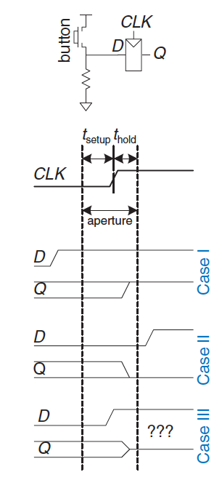
Metastability (1)
It is not always possible to guarantee that the input to a sequential circuit is stable during the aperture time
especially when the input arrives from the external world
Consider a button connected to the input of a flip-flop
when the button is pressed much before CLK, Q = 1
when the button is not pressed until long after CLK, Q = 0
when the button is pressed between t_{setup} before CLK and t_{hold} after CLK, the input violates the dynamic discipline and the output is undefined
When a flip-flop samples an input changing during the aperture, output may momentarily go in forbidden zone
metastable state
eventually, it will resolve to a stable state, however, the resolution time required is unbounded

Slide 26
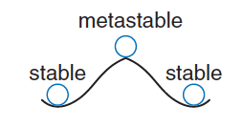
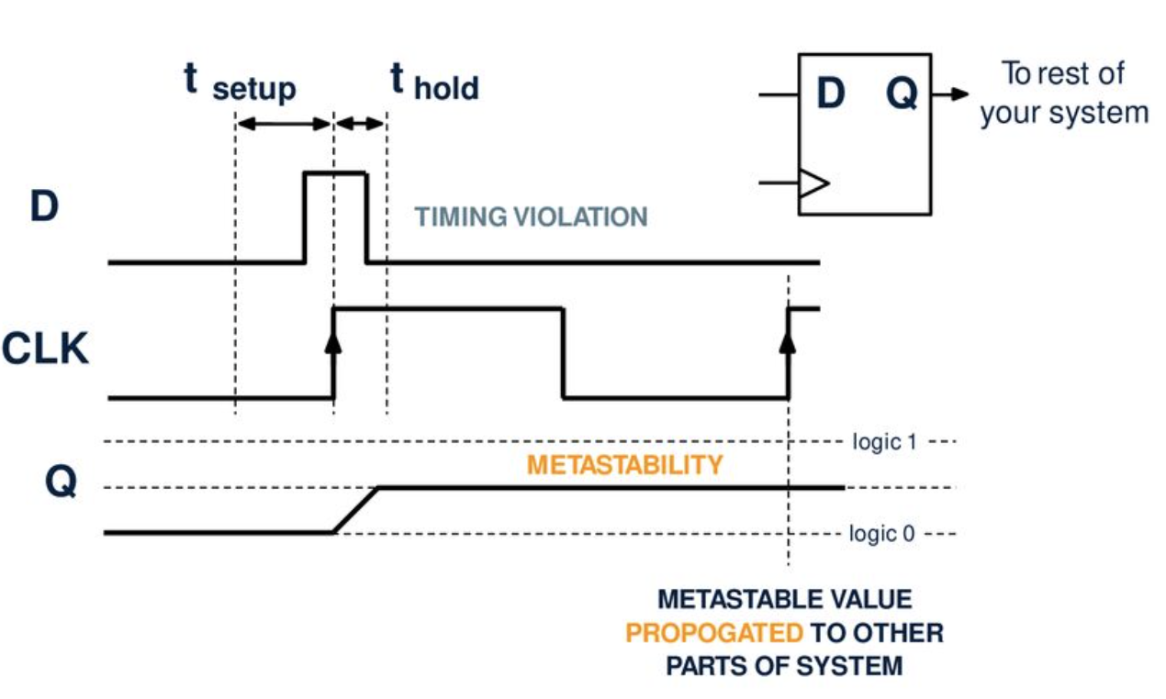
Metastability (2)
The metastable state of a flip-flop is analogous to a ball on the summit of a hill between two valleys
valleys are stable states, the top of the hill is metastable
the ball would remain there if it were perfectly balanced, but because nothing is perfect, the ball will eventually roll to one side or the other
the time required for this change to occur depends on how nearly well balanced the ball originally was
Every bistable device has a metastable state between the two stable states

Slide 27
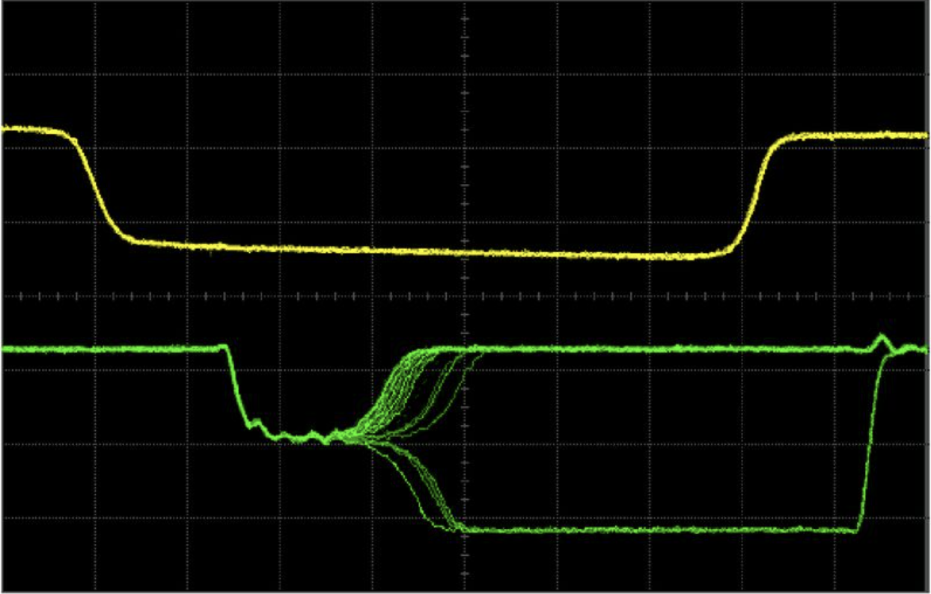
Resolution Time
The resolution time is a random variable
Theoretical and experimental analyses have shown that the probability that the resolution time exceeds some arbitrary time t decreases exponentially with t
p(t_{res} > t) = T₀ / T_{C} * exp (-t/τ)
where T_{C} is the clock period, and T₀ and τ are characteristic of the flipflop
the equation is valid only for t substantially longer than t_{pcq}
This means that time required to resolve is unbounded, however if we wait long enough the flip-flop will reach a valid logic level

Slide 28
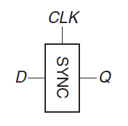
Synchronizers (1)
Asynchronous inputs to digital systems from the real world are inevitable
human input is asynchronous
can lead to metastable voltages and erratic system failures
Ensure that the probability of encountering a metastable voltage is “small”
cell phone: one failure in 10 years is acceptable, the user can turn the phone off and on
medical device, one failure in the expected life of the universe is a better target
A synchronizer is a device that receives an asynchronous input D and a clock CLK and produces a valid output Q with high probability
If D is stable during the aperture, Q should take on the same value as D
If D changes during the aperture, Q may take HIGH or LOW, but must not be metastable

Slide 29
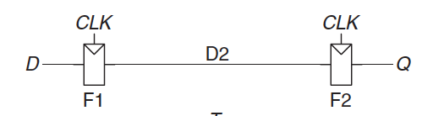
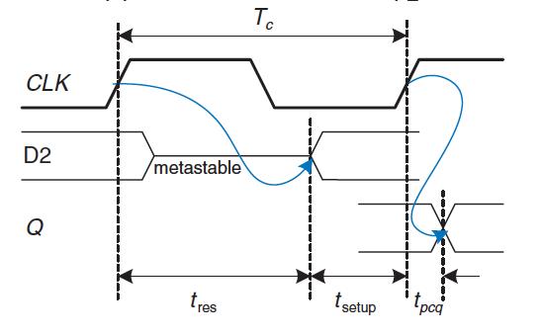
Synchronizers (2)
We can build a simple synchronizer out of two flip-flops
F1 samples D on the rising edge of CLK
if D is changing at that time, the output D2 may be momentarily metastable
if clock period is long enough, D2 (with high probability), resolve to a valid logic level
F2 samples D2 (now stable), producing a good output Q
The synchronizer fails if Q becomes metastable
if D2 has not resolved to a valid level by the time t_{res} > T_{C} − t_{setup}
The probability of failure for a single input is
p(failure) = T₀ / T_{C} * exp (-(T_{C}-t_{setup})/τ)
If D changes N times per second, the probability of failure per second is
P(failure)/sec = N * p(failure)

Slide 30
System reliability
It is measured in mean time between failures (MTBF)
the average amount of time between failures of the system
the reciprocal of the probability that the system will fail in any given second
MTBF = 1 / p(failure)/sec = T_{C}/NT₀ * exp ((T_{C}-t_{setup})/τ)
MTBF improves exponentially as the synchronizer waits for a longer time
for most systems, to wait for one clock cycle provides a safe MTBF
in exceptionally high-speed systems, waiting for more cycles may be necessary
A system receives asynchronous inputs from the sensors on average 0.2 times per second. How long must be the clock period for the MTBF to exceed 1 year?
the flip-flops in the synchronizer have the following characteristics: τ=200ps, T₀=150ps, and t_{setup}=500ps
3.14 10⁷ sec = T_{C}/(0.2 * 150 10⁻¹²) * exp ((T_{C} – 500 10⁻¹²) / 200 10⁻¹²)
no closed form solution, however, it is easy enough to solve by guess and check
Tc = 3.036 ns

Slide 31
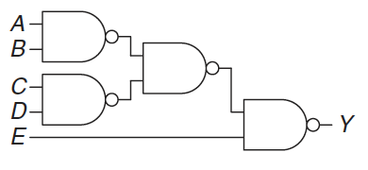
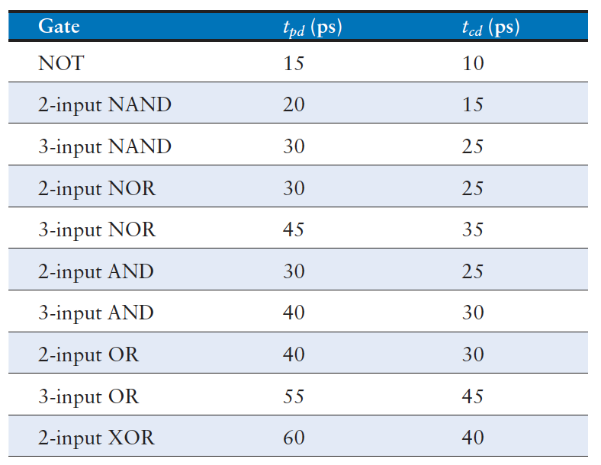
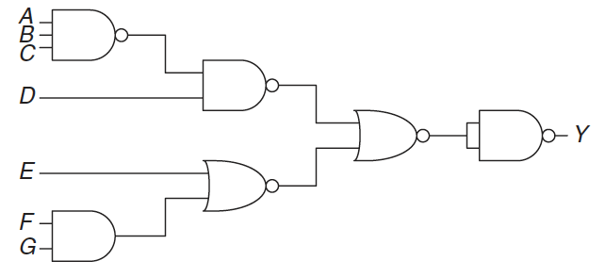
Exercises (1)
Ex1: Determine the propagation delay and contamination delay of the following circuits using the provided gate delays
Solution:
t_{pd} = 3 t_{pd_NAND2} = 60 ps
t_{cd} = t_{cd_NAND2} = 15 ps
t_{pd} = t_{pd_NAND2} + 2 t_{pd_NOR2} + t_{pd_NAND2} = 30 + 2*30 + 20 = 110 ps
t_{cd} = 2 t_{cd_NAND2} + t_{cd_NOR2} = 2*15 + 25 = 55 ps

Slide 32
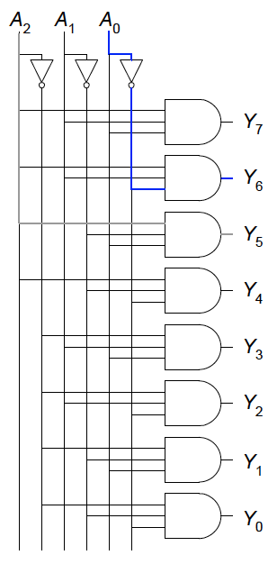
Exercises (2)
Ex2: Sketch a schematic for a fast 3:8 decoder. Suppose gate delays are the same of the previous exercise. Design your decoder to have the shortest possible critical path and indicate what that path is. What are its propagation delay and contamination delay?
Solution:
t_{pd} = t_{pd_NOT} + t_{pd_AND3} = 15 + 40 = 55 ps
t_{cd} = t_{cd_NAND3} = 30 ps

Slide 33
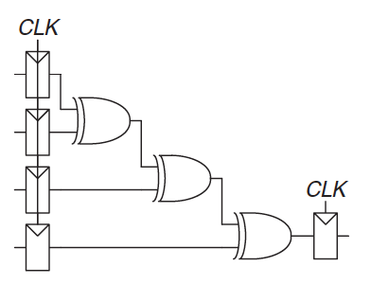
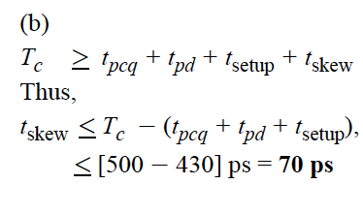

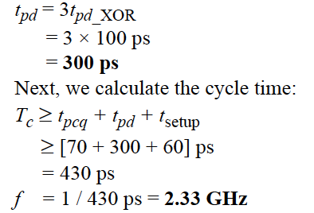

Exercises (3)
Ex3: Consider the circuit in figure to compute a registered four-input XOR function. Gates have a t_{pd}=100ps and a t_{cd}=55ps. Flip-flops have a t_{setup}=60ps, a t_{hold}=20ps, t_{pcq}=70ps, and a t_{ccq}=50ps
(a) if there is no clock skew, what is the maximum frequency?
(b) how much clock skew can the circuit tolerate at 2 GHz?
(c) how much clock skew can the circuit tolerate before a hold time violation?
Solution:

